Slide 1
Performance Simulator
Dec 29, 2024

Slide 2
The need
High variability in population and data
Key questions:
What is the expected performance/cutoff for this site?
Acknowledging differences in population and reference cutoff/performance:
Population Variability: Is this expected, based on differing demographics?
Technical Integration: Could discrepancies arise from issues like improper filtering? Not enough history?
Use Case Fit: Could the model be misaligned with the intended application?

Slide 3

Internal Operative Tool Overview
Designed for rough estimation of cutoff/performance while controlling differences in population characteristics
Provide quick insights to point out root causes and what-if analysis

Slide 4
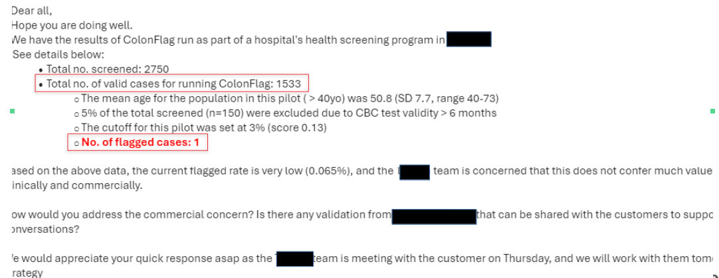
Demo - real use case

Slide 5
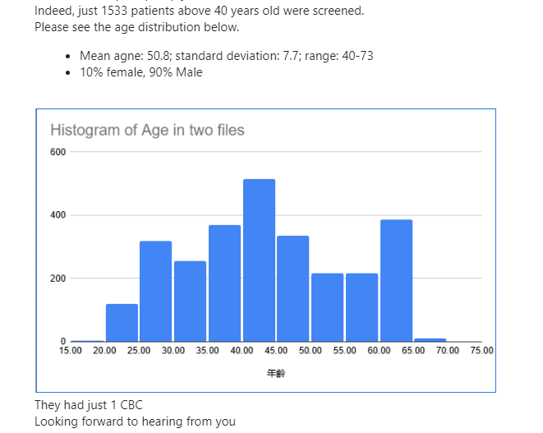
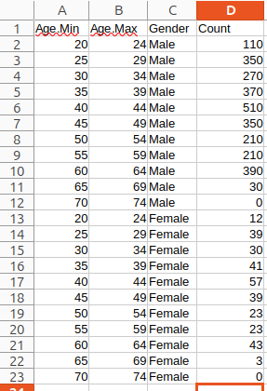
Demo cont.
Converted to excel

Slide 6
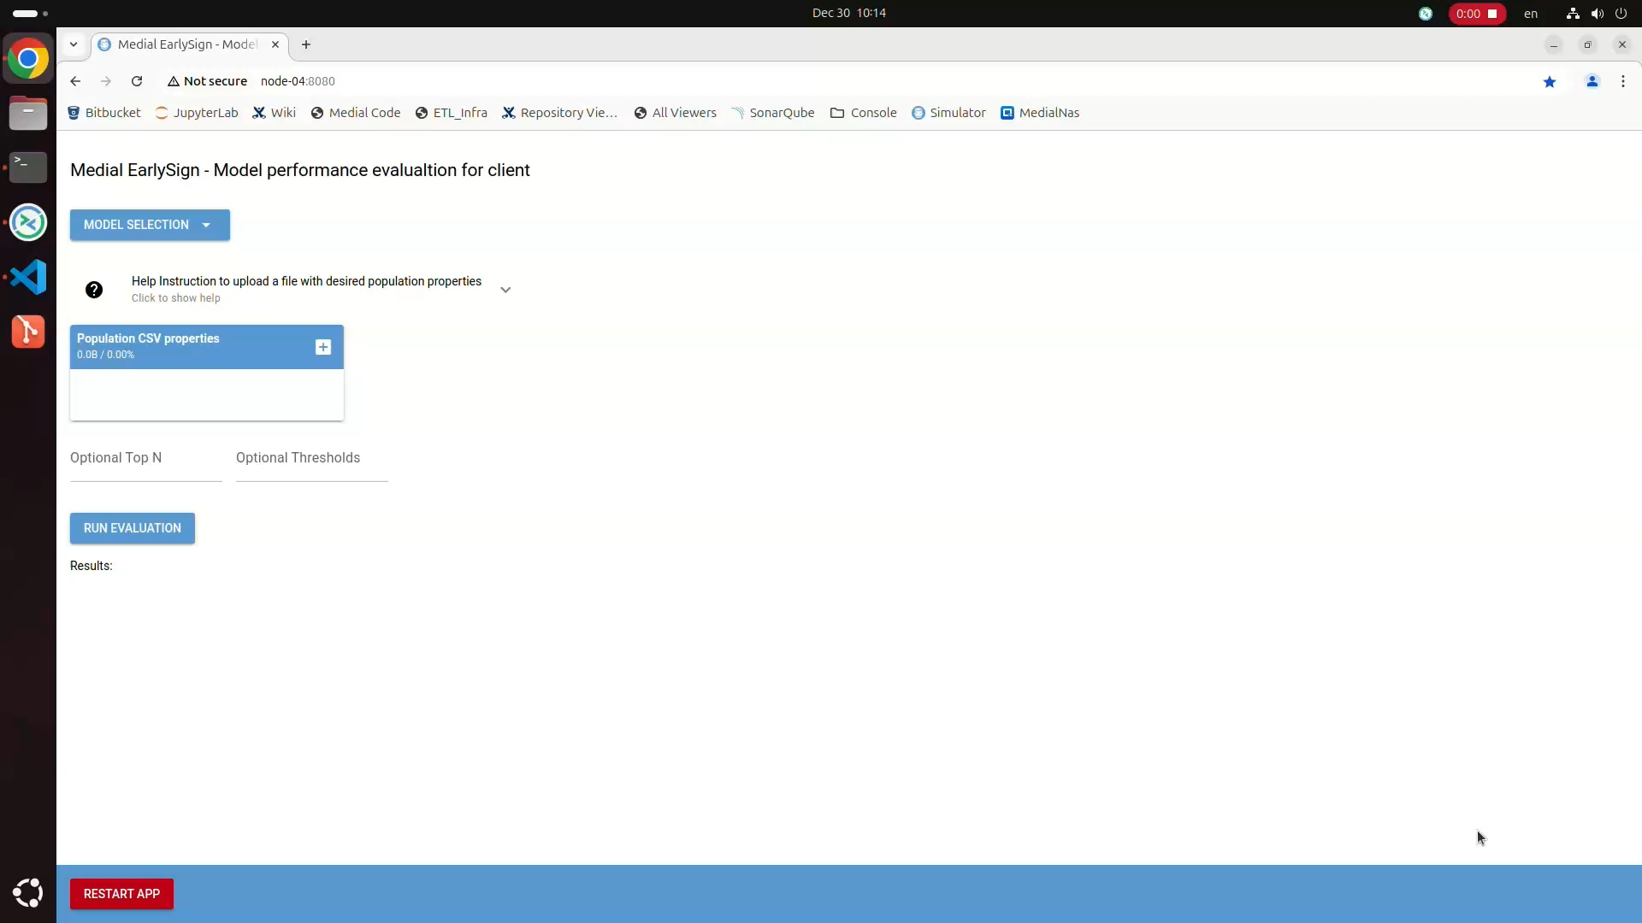
Live Demo

Slide 7
Demo – summary
Above cutoff > 0.13, client got 1/1500 flags. Simulation expectations is 0.1% which is 1-2 flags
3% flag rate:
Suggested by the simulation for this cohort: 0.052
Observed cutoff on actual data: 0.042
Another Example for X retrospective validation
Suggested by the simulation considering age distribution and history availability: ~0.07
Observed cutoff on actual data: ~0.06

Slide 8
Feedback

Slide 9
Discussion
Might help to shorten response time to answer customers
Get a better estimation of the cutoff/value for our customer

